Slide 1
First-Order Logic

Slide 2
Contents
More on Representation
Syntax and Semantics of First-Order Logic
Using First Order Logic
Knowledge Engineering in First-Order Logic

Slide 3
First-Order Logic
AKA First-Order Predicate Logic
AKA First-Order Predicate Calculus
Much more powerful the propositional (Boolean) logic
Greater expressive power than propositional logic
We no longer need a separate rule for each square to say which other squares are breezy/pits
Allows for facts, objects, and relations
In programming terms, allows classes, functions and variables

Slide 4
Pros and Cons of Propositional Logic
+ Propositional logic is declarative: pieces of syntax correspond to facts
+ Propositional logic allows for partial / disjunctive / negated information
+ Propositional logic is compositional: the meaning of B₁₁ ^ P₁₂ is derived from the meaning of B₁₁ and P₁₂
- Propositional logic has very limited expressive power: (unlike natural language)
E.g. cannot say Pits cause Breezes in adjacent squares except by writing one sentence for each square

Slide 5
Pros of First-Order Logic
First-Order Logic assumes that the world contains:
Objects
E.g. people, houses, numbers, theories, colors, football games, …
Relations
E.g. red, round, prime, bogus, multistoried, brother of, bigger than, inside, part of, has color, occurred after, owns, comes between, …
Functions
E.g. father of, best friend, one more than, beginning of, …

Slide 6
Logics in General
Language | Ontological Commitment | Epistemological Commitment
Propositional Logic | Facts | True / False / Unknown
First-Order Logic | Fact, objects, relations | True / False / Unknown
Temporal Logic | Facts, objects, relations, times | True / False / Unknown
Probability Theory | Facts | Degree of belief ∈ [0,1]
Fuzzy Logic | Degree of truth ∈ [0,1] | Known interval value

Slide 7
Syntax of First-Order Logic
Constants KingJohn, 2, …
Predicates Brother, >, …
Functions Sqrt, LeftArmOf, …
Variables x, y, a, b, …
Connectives ∧ ∨ ¬ ⇒ ⇔
Equality =
Quantifiers ∃ ∀

Slide 8
Components of First-Order Logic
Term
Constant, e.g. Red
Function of constant, e.g. Color(Block1)
Atomic Sentence
Predicate relating objects (no variable)
Brother (John, Richard)
Married (Mother(John), Father(John))
Complex Sentences
Atomic sentences + logical connectives
Brother (John, Richard) ∧¬Brother (John, Father(John))

Slide 9
Components of First-Order Logic
Quantifiers
Each quantifier defines a variable for the duration of the following expression, and indicates the truth of the expression…
Universal quantifier “for all” ∀
The expression is true for every possible value of the variable
Existential quantifier “there exists” ∃
The expression is true for at least one value of the variable

Slide 10
Truth in First-Order Logic
Sentences are true with respect to a model and an interpretation
Model contains -> 1 object (domain elements) and relations among them
Interpretation specifies referents for
constant symbols -> objects
predicate symbols -> relations
function symbols -> functional relations
An atomic sentence predicate( term₁,…,term_{n}) is true iff the objects referred to by term₁,…,term_{n} are in the relation referred to by predicate

Slide 11
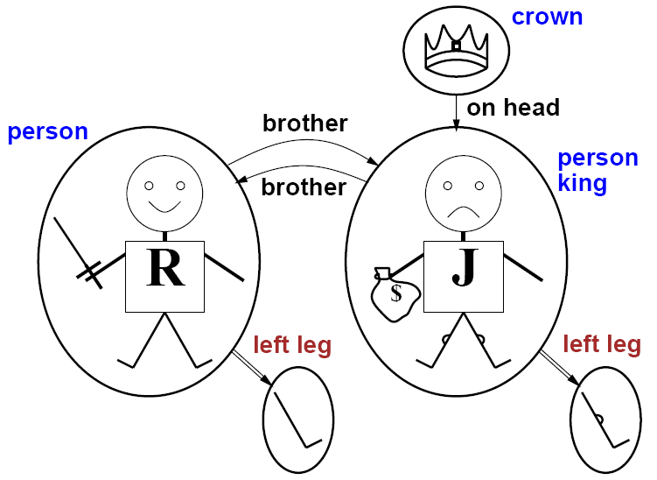
First-Order Logic Example

Slide 12
Universal Quantification
Are used for expressing properties of entire collection of objects, rather than just a single object
∀ <variables> <sentence>
∀x P is true in a model m iff P is true for all objects x in model.
For Example:
“All Princess are Person” …can be represented as:
∀x Princes⇒ Person(x)

Slide 13
A Common Mistake to Avoid
Typically ⇒ is the main connective with ∀
Common mistake: using ∧ as the main connective with ∀
∀x At(x, IIT) ∧ Genius(x)
Everyone at IIT is Genius…….

Slide 14
Existential Quantification
∃ <variables> <sentence>
∃ x P is true in a model m iff P is true for at least one possible object in the model
Equivalent to the disjunction of instantiations of P
“Princess John has crown on his Head “
∃ x Crown(x) ∧ OnHead (x, John)

Slide 15
Another Common Mistake to Avoid
Typically, ∧ is the main connective with ∃
Common mistake: using ⇒ as the main connective with ∃
∃ x Crown(x) ⇒ OnHead (x, John)

Slide 16
Examples
Everyone likes McDonalds
∀x, likes(x, McDonalds)
Someone likes McDonalds
∃x, likes(x, McDonalds)
All children like McDonalds
∀x, child(x) ⇒ likes(x, McDonalds)
Everyone likes McDonalds unless they are allergic to it
∀x, ¬allergic (x, McDonalds) ⇒ likes(x, McDonalds)

Slide 17
Properties of Quantifiers
∀x ∀y is the same as ∀y ∀x
∃x ∃y is the same as ∃y ∃x
∃x ∀y is not the same as ∀y ∃x
∃x ∀y Loves(x, y)
“There is a person who loves everyone in the world”
∀y ∃x Loves(x, y)
“Everyone in the world is loved by at least one person”

Slide 18
Nesting Quantifiers
Everyone likes some kind of food
∀y ∃x, food(x) ∧ likes(y, x)
There is a kind of food that everyone likes
∃x ∀y, food(x) ∧ likes(y, x)
Someone likes all kinds of food
∃y ∀x, food(x) ∧ likes(y, x)
Every food has someone who likes it
∀x ∃y, food(x) ∧ likes(y, x)

Slide 19
Examples
Quantifier Duality
Not everyone like McDonalds
¬(∀x, likes(x, McDonalds))
∃x, ¬likes(x, McDonalds)
No one likes McDonalds
¬(∃x, likes(x, McDonalds))
∀x, ¬likes(x, McDonalds)

Slide 20
Fun with Sentences
Brothers are siblings
∀x,y Brother(x,y) ⇒ Sibling(x, y)
Sibling is “symmetric”
∀x,y Sibling(x,y) ⇔ Sibling(y, x)

Slide 21
Fun with Sentences
One’s mother is one’s female parent
∀x,y Mother(x,y) ⇔ (Female(x) ∧ Parent(x,y))
A first cousin is a child of a parent’s sibling
∀x,y FirstCousin(x,y) ⇔ ∃p,ps Parent(p,x) ∧ Sibling(ps,p) ∧ (Parent(ps,y)

Slide 22
Other Comments About Quantification
To say “everyone likes McDonalds”, the following is too broad!
∀x, likes(x, McDonalds)
example: likes (McDonalds, McDonalds)
We mean: Every one (who is a human) likes McDonalds
∀x, person(x) ⇒ likes(x, McDonalds)
Essentially, the left side of the rule declares the class of the variable x
Constraints like this are often called “domain constraints”

Slide 23
Equality
We allow the usual infix = operator
Here two terms refer to the same objects
Father(John) = Henry
∀x, sibling(x, y) ⇒ ¬(x=y) //when objects are not same
Example: (Sibling in terms of Parent)
∀x,y Sibling(x,y) ⇔ [¬(x=y) ∧ ∃m,f ¬(m=f) ∧ Parent(m,x) ∧ Parent(f,x) ∧ Parent(m,y) ∧ Parent (f,y)]

Slide 24
Example Domains
Kinship domain
Numbers, sets, and lists
The Wumpus World

Slide 25
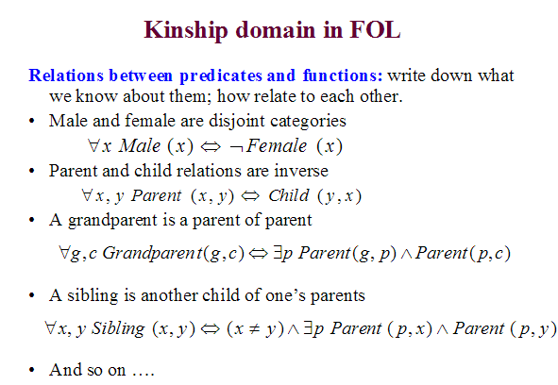

Slide 26
Interacting with FOL KBs
Tell the system assertions
Facts :
Tell (KB, person (John) )
Rules:
Tell (KB,∀x, person(x) ⇒ likes(x, McDonalds))
Ask questions
Ask (KB, person(John))
Ask (KB, likes(John, McDonalds))
Ask (KB, likes(x, McDonalds))

Slide 27
Types of Answers
Fact is in the KB
Yes.
Fact is not in the KB
Yes (if it can be proven from the KB)
No (otherwise)
Fact contains variables
List of bindings for which the fact can be proven, e.g. ((x Fred) (x Mary) … )

Slide 28
Interacting with FOL KBs
Suppose a wumpus-world agent is using a FOL KB and perceive a smell and breeze (but no glitter) at t=5
TELL(KB, Percept([Smell, Breeze, None],5))
ASK(KB, ∃a Action(a, 5))
i.e. does the KB entail any particular action at t=5?
Answer: Yes, {a/Shoot} <- substitution (binding list)

Slide 29
Knowledge Base for Wumpus World
“Perception”
∀ b, g, t Percept([Smell, b, g], t) ⇒ Smelt(t)
∀ s, b, t Percept([s, b, Glitter], t) ⇒ AtGold(t)
“Reflex”
∀ t AtGold(t) ⇒ Action(Grab, t)
“Reflex with internal state”
∀ t AtGold(t) ∧ ¬Holding(Gold, t) ⇒ Action(Grab, t)
Holding( Gold, t ) cannot be observed
Keeping track of change is essential!!!!

Slide 30
Deducing Hidden Properties
Squares are breezy near a pit:
Diagnostic Rule – infer cause from effect
∀y Breezy(y) ⇒ ∃x Pit(x) ∧ Adjacent( x, y )
Causal Rule – infer effect from cause
∀x,y Pit(x) ∧ Adjacent(x,y) ⇒ Breezy(x,y)
Neither is complete
E.g. the causal rule doesn’t say whether squares far away from pits can be breezy

Slide 31
Deducing Hidden Properties
Definition for the Breezy predicate:
If a square is breezy, some adjacent square must contain a pit
∀y Breezy(y) ⇒ ∃x Pit(x) ∧ Adjacent( x, y )
If a square is not breezy, no adjacent pit contains a pit
∀y ¬Breezy(y) ⇒ ¬∃x Pit(x) ∧ Adjacent( x, y )
Combining these two…
∀y Breezy(y) ⇔ ∃x Pit(x) ∧ Adjacent( x, y )

Slide 32
Keeping Track of Change
Often, facts hold in situations, rather than eternally
E.g. Holding( Gold, now ) rather than just Holding( Gold )
Situation calculus is one way to represent change in FOL:
Adds a situation argument to each non-eternal predicate
E.g. Now in Holding(Gold, Now) denotes a situation

Slide 33
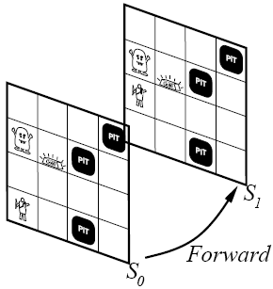
Keeping Track of Change
Situations are connected by the Result function Result( a, s ) is the situation that results from doing a in s

